Slide 1
Classification of CS papers citation network using Graph Machine Learning techniques
By: Kulkarni Yash Rajendra, Vikram Akula, Venkata Manohar Krishna Pasala

Slide 2
Introduction
CS paper citation network consists of 169343 nodes classified into 40 different classes
Papers are considered as nodes and citations as an edges
Node Embeddings are low dimensional vectors that reflect properties of nodes in a network.
They are typically used as input to downstream machine learning tasks such as node classification.
Node co-occurrence embeddings is a subclass of simple graph embeddings which use node co-occurrence information form random walks generated on a graph.
These embeddings mainly differ in they way they generate these random walks.
We implement 3 embeddings Deepwalk, Node2Vec and GraRep from scratch.
We use these embeddings on a downstream Node Classification task on ogbn-arxiv dataset.

Slide 3
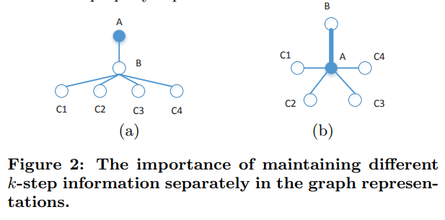
GraRep
GraRep was introduced by Cao et al. 2015, after Deep walk and Skip gram models.
It incorporated integrates global structural information of the graph into the learning process.
However it uses implicit matrices rather than a word co-occurence model to calculate embeddings.
The papers concatenates both 1-step and 2-step relational information to form the representations.
The paper argues SGNS is a special case of the GraRep model.
Notes:
Read the caption from the figure on the right

Slide 4
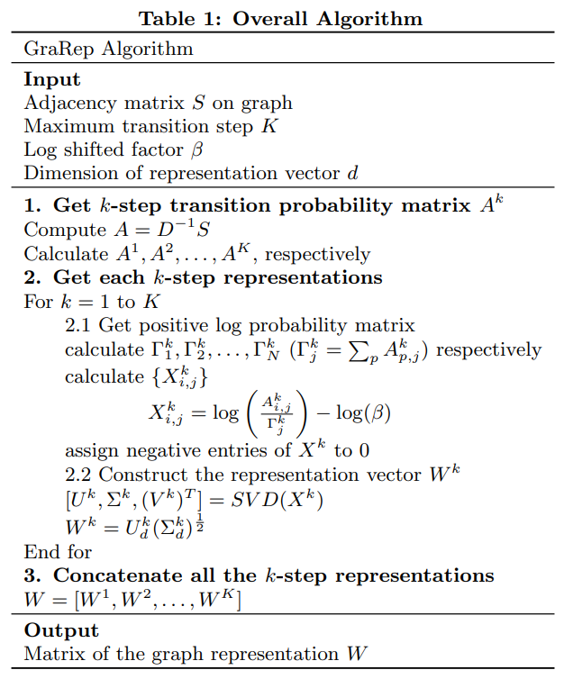
Notes:
Beta = lambda/N, where lambda is a hyper parameter controlling negative sapling and N is the total number of nodes. A is the (1-step) probability transition matrix. The equation for X in 2.1 is derived from optimizing noise contrastive estimation (NCE) in matrix form ie. we equate its derivative to zero.

Slide 5
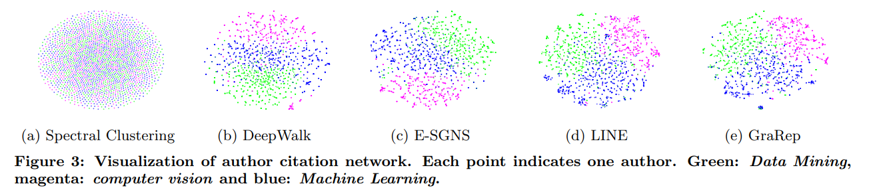
Results
Notes:
Figure 3 shows node embeddings from DBLP dataset visualized on a 2-dimensional space using t-sne.

Slide 6
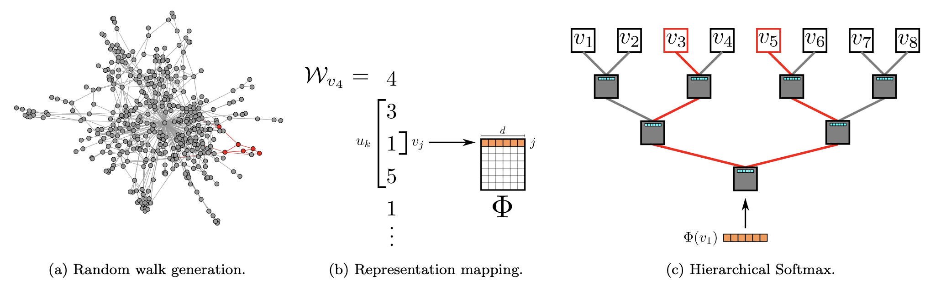
DeepWalk
Generate random walks from each node
Cooccurrences as input to the Skip-Gram model

Slide 7
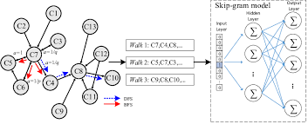
Node2Vec
It uses a combination of the algorithms DFS and BFS to extract the random walks

Slide 8
Results :
Model : Logistic Regression
Embedding | Deepwalk | Node2vec | GraRep
Accuracy | 59% | 50% | 15%

